Slide 1

Password Generator: Secure and Customizable
Introducing a powerful password generator that combines security and flexibility. With this tool, you can create unique, strong passwords tailored to your specific needs, ensuring the protection of your online accounts.
by
Pulkit Srivastav [RA2311028030040]
Prateek Kumar Srivastava [RA2311028030009]

Slide 2

Introduction to Password Generators
1
Secure Passwords
2
Customization
Password generators create complex, random passwords that are resistant to hacking and data breaches.
Users can customize password length, character types, and other preferences to fit their specific requirements.
3
Convenience
Automatic password generation saves time and eliminates the need to manually create and remember passwords.

Slide 3
The Importance of Strong Passwords
Preventing Fraud
Data Protection
Online Safety
Strong, unique passwords help protect against unauthorized access and identity theft.
Secure passwords are crucial for safeguarding sensitive information and personal data.
Robust password practices contribute to overall online security and peace of mind.

Slide 4
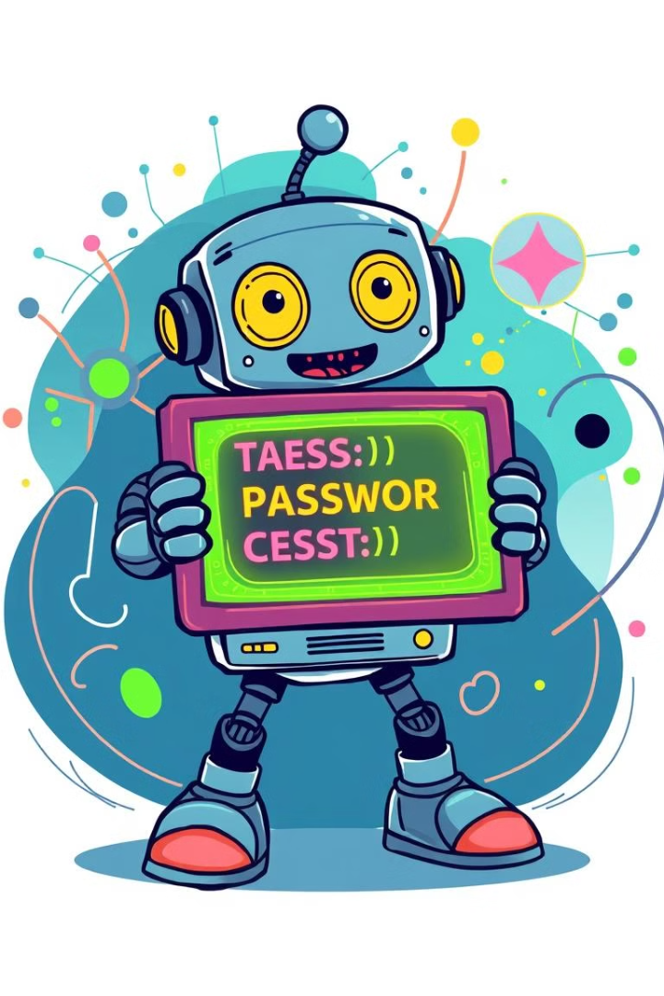
Generating Passwords with Java
1
Random Character Generation
Use Java's built-in random number generator to create a sequence of characters for the password.
2
Customization Options
Incorporate user preferences for password length, character types, and other settings.
3
Password Validation
Ensure the generated password meets the desired complexity and security requirements.

Slide 5
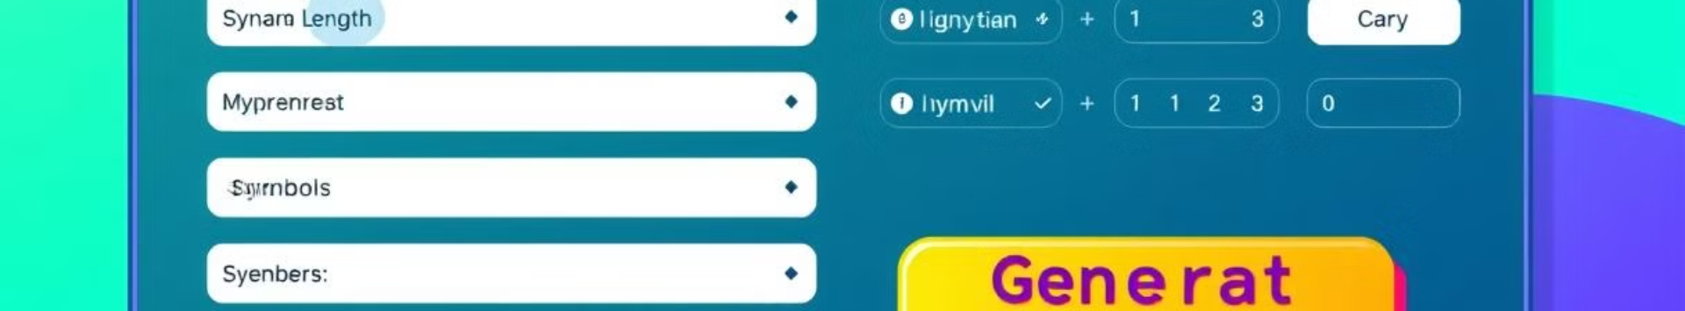
Customizing Password Preferences
Password Length
Character Types
Allow users to specify the desired length of the generated password, typically 8-16 characters.
Offer options to include or exclude letters, numbers, and special characters in the password.
Memorable Patterns
Exclusion List
Provide the ability to generate passwords with recognizable patterns for easier recall.
Enable users to specify characters or words to be excluded from the generated password.

Slide 6




Ensuring Password Uniqueness
Password Tracking
Verification
Regeneration
Store generated passwords in a secure database to prevent duplicates.
Implement checks to ensure each new password is distinct from previously generated ones.
Provide an option to generate a new password if the user is unsatisfied with the initial one.

Slide 7
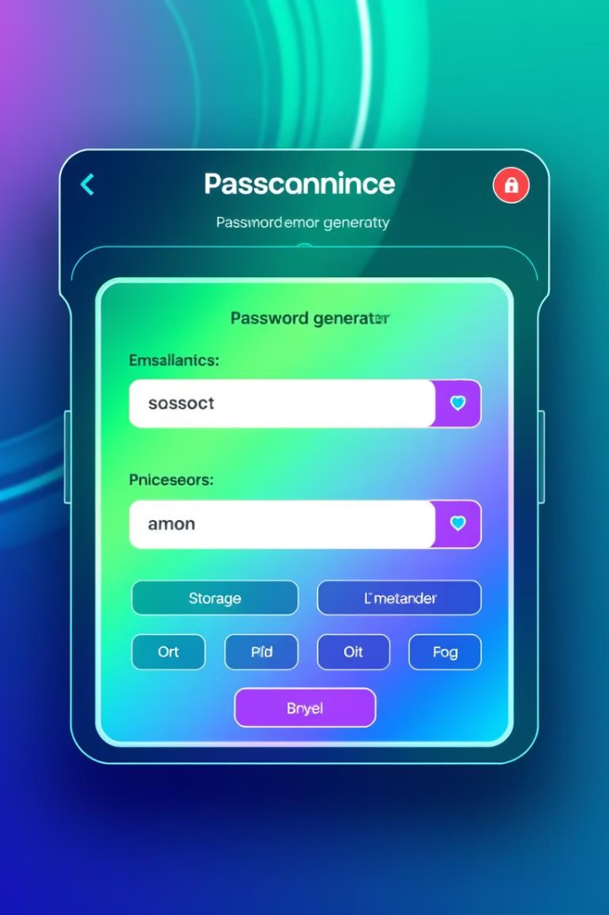



Displaying and Storing Generated Passwords
Password Display
Show the generated password clearly and prominently on the user interface.
Clipboard Integration
Allow users to easily copy the password to their clipboard for immediate use.
Secure Storage
Provide an optional password manager to securely store the generated passwords.

Slide 8
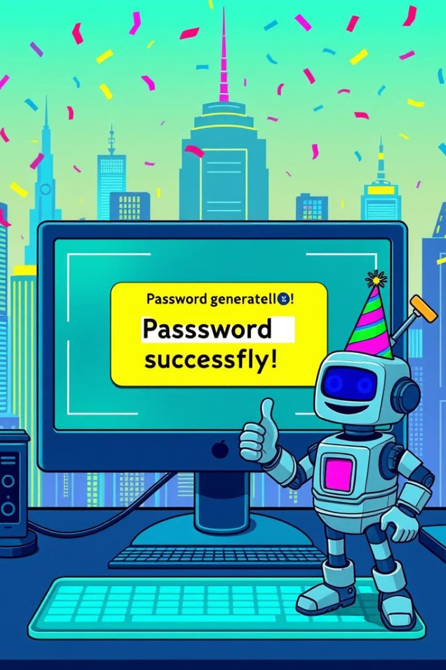
Conclusion and Key Takeaways
This password generator empowers users to create strong, customizable passwords that prioritize security and convenience. By incorporating these features, you can help your users protect their online accounts and sensitive information with confidence.

Slide 9
THANKS !

